Slide 1
Unit 202: Principles of electrical science
Basic mechanics

Slide 2
Basic mechanics
Mass
Mass can be defined as the amount of material in an object. The SI unit of mass is the kilogram (kg).
Acceleration
When an aircraft takes off, it starts from rest and increases its velocity until it can fly. This change in velocity is called acceleration. Acceleration is the change in velocity with time.
Acceleration | = | final velocity (v) - initial velocity(u) | (m/s²)
 |  | Time

Slide 3

Basic mechanics
EXAMPLE 1. If a car accelerates from a velocity of 3 m/s to 15 m/s in 4 seconds, calculate its average acceleration.
Average velocity | = | $$\frac{v −u}{t}m/s$$
Average acceleration | = | $$\frac{15 −3}{4}$$
Average acceleration | = | 12
 |  | 4
 | = | 3m/s²
Thus, the average acceleration is 3 metres per second, every second.

Slide 4
Basic mechanics
Force
The SI unit of force is the Newton (N).
A mass of 1 kilogram experiences a force of 9.81 Newtons as a result of gravity. In other words, it would require a force of 9.81 Newtons to raise a mass of 1kg against the pull of gravity (on Earth).
To calculate the force on a body due to gravity (on earth) multiply its mass by 9.81.

Slide 5
Basic mechanics
EXAMPLE 2. A bundle of conduit has a mass of 800kg. What force will be required to lift it?
Force required | = | Mass × Acceleration due to gravity
 | = | 800 × 9.81
 | = | 7,848 Newtons

Slide 6
Basic mechanics
Work done
Force is measured in Newtons
Work done is measured in Newton metres (Nm)

Slide 7
Basic mechanics
EXAMPLE 3. What work must be done to lift a 800kg bundle of conduit from the floor on to a rack 2 metres high?
Work done | = | Force x distance
 | = | 800 × 9.81 × 2
 | = | 15,696 Nm

Slide 8
Basic mechanics
Energy
Energy is the capacity for doing work. It may exist in potential, kinetic, thermal, electrical, chemical, nuclear, or other various forms.
The units of energy is the Newton-metre or Joule.

Slide 9
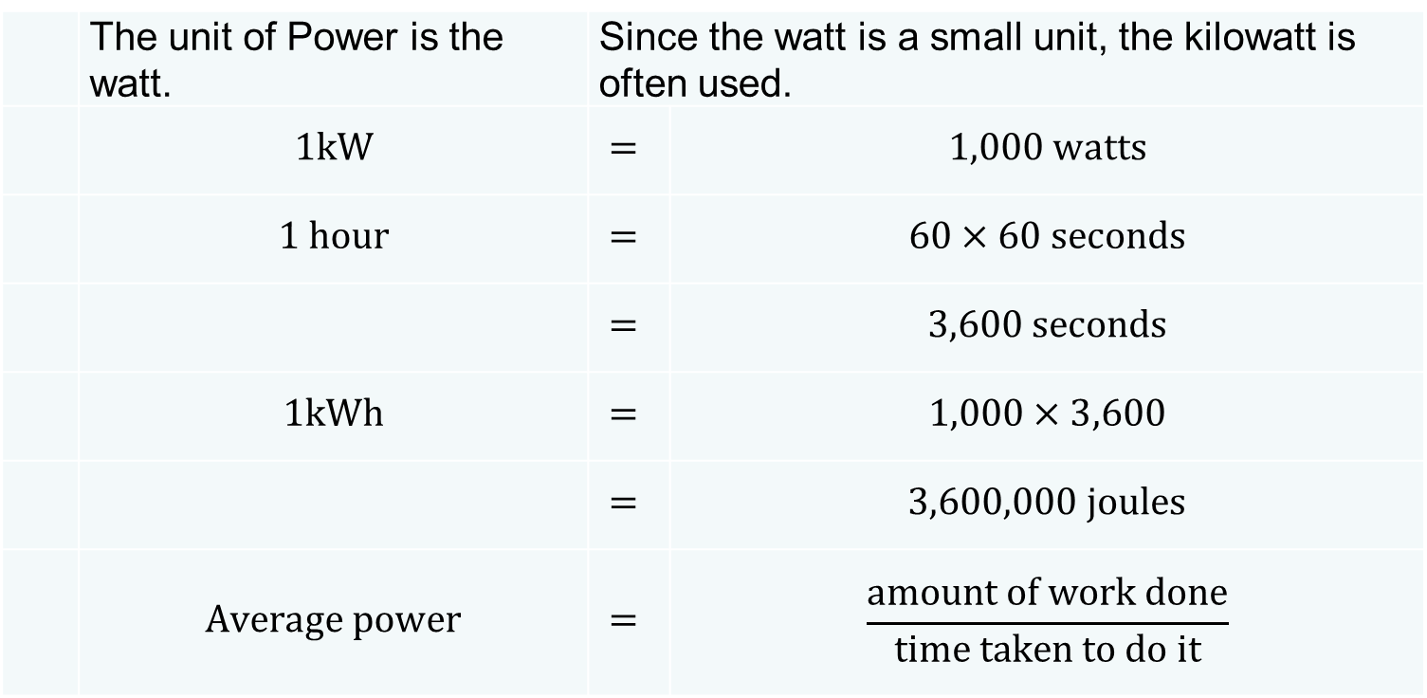
Basic mechanics
Power
POWER is defined as THE RATE OF DOING WORK.
 | The unit of Power is the watt. | Since the watt is a small unit, the kilowatt is often used.
 | $$1kW$$ | $$=$$ | $$1,000 watts$$
 | $$1 hour$$ | $$=$$ | $$60×60 seconds$$
 |  | $$=$$ | $$3,600 seconds$$
 | $$1kWh$$ | $$=$$ | $$1,000×3,600$$
 |  | $$=$$ | $$3,600,000 joules$$
 | $$Average power$$ | $$=$$ | $$\frac{amount of work done}{time taken to do it}$$

Slide 10
Basic mechanics
Efficiency
The efficiency of a system can be defined as the ratio of output power to input power and is usually expressed as a percentage.

Slide 11

Basic mechanics
EXAMPLE 4. A motor produces 100 watts output power and is:
50% efficient
70% efficient.
Calculate its input power in each case.
 | Efficiency | = | Output power | × 100
 |  |  | Input power
 | Input power | = | Output power | × 100
 |  |  | Efficiency
a) | Input power | = | 100 | × 100
 |  |  | 50
 | = | 200 watts

Slide 12

Basic mechanics
 | Input power | = | Output power | × 100
 |  |  | Efficiency
b) | Input power | = | 100 | × 100
 |  |  | 70
 | = | 142.86 watts

Slide 13
Basic mechanics
EXAMPLE 5. An electric motor drives a pump that lifts 1,000 litres of water each minute to a tank 20 metres above ground level. Calculate the power that the motor must provide if the pump is only:
50% efficient
80% efficient.
Work | = | Force × distance
NB: One litre of water weighs 1kg (1kg = 9.81N)
Force | = | Mass in kg × 9.81
 | = | 1,000 × 9.81 × 20
 | = | 196,200Nm/minute or joules
Joules | = | Watts × seconds
 | Watts | = | Joules
 |  |  | seconds
 |  | = | 196,200
 |  |  | 60
 | = | 3,270 Watts (output power)

Slide 14
Basic mechanics
 | Efficiency | = | Output power | × 100
 |  |  | Input power
 | Input power | = | Output power | × 100
 |  |  | Efficiency
a) | Input power | = | 3,270 | × 100
 |  |  | 50
 | = | 6,540 watts

Slide 15
Basic mechanics
 | Input power | = | Output power | × 100
 |  |  | Efficiency
b) | Input power | = | 3,270 | × 100
 |  |  | 80
 | = | 4,087.5 watts

Slide 16
Unit 202: Principles of electrical science
The End

